Slide 1

Don’t take the bait
How to stop and avoid phishing emails
Notes:
Phishing is a big issue that we all need to be aware of – and play our part in stopping. It impacts both our organization, but also your personal life too.
In this session we’re going to look at:
- The different types of phishing
- Can you spot a phishing email
- Ten tell tale signs of a phish
- And then some tools to help you avoid phishing in the future

Slide 2
What is Phishing?
Any type of attempt to trick you into doing something to benefit the crooks.
Opening an attachment in email
Clicking on a link
Sharing confidential information
Transferring funds
MASS
PHISHING
SPEAR
PHISHING
Notes:
Phishing is any type of attempt to trick you into doing something to benefit the crooks.
Overwhelmingly, cyber criminals are interested in money. Either they’ll extort money from you using ransomware or social engineering, or they’ll steal data and credentials that can be sold on.
And what started as simply “phishing” has now evolved into two main tactics of phishing attack – Mass Phishing and Spear Phishing.

Slide 3
Mass Phishing
Target: Individuals’ Assets e.g. bank accounts, identity, login credentials.
Typically aimed at consumers
Impersonal: mass email mail outs
Credentials used or sold for financial gain
Notes:
Mass phishing attacks particularly target you as individuals: your data, your money, your credentials.
These attacks are largely opportunistic, taking advantage of a company’s brand name to try and lure the brand’s customers to spoofed sites where they are tricked into parting with credit card information, login credentials, and other personal information that will be later resold for financial gain.
Typically impersonal batch and blast emails
They’re focused on stealing personal data, such as login credentials that can be sold on

Slide 4
Spear Phishing
Target: The assets of a specific organization e.g. data, money
Typically target an individual or specific group in an organization
Often use spoofed (look-a-like) email addresses
Impersonate trusted sources and senior executives
Notes:
The other kind of threat is of the spear phishing variety, where emails impersonating a specific sender or trusted source are sent to targeted individuals within organizations to try to get them to take certain actions, like sending money to spurious accounts.
These are usually harder to spot, with spoofed email addresses that look like the real thing used to fool you into replying or clicking. They also particularly target businesses.

Slide 5

Phishing Motives
41%
Unauthorized Access
59%
Financial Gain
Verizon 2018 Data Breach Investigations Report
Notes:
Phishing is a concern for every organization. A recent Sophos survey revealed that a massive 41% of IT Pros report at least daily phishing attacks on their organization, and over three quarters (77%) experience attacks at least every month.
[CLICK]
When it comes to the motives behind the attack, 59% have a direct financial goal – either through harvesting of credential for resale, infecting systems with ransomware, or impersonating senior managers to convince employees to transfer them funds or valuable employee data.
[CLICK] and 41% of phishing attacks motivated by trying to obtain access to a company’s network to steal data, gain control of systems and so on.

Slide 6



What do these brands have in common?
3 Most Spoofed Brands in Phishing Attacks
Notes:
Now a question for you.
What do these three brands have in common: Apple, Amazon, Microsoft.
They are the three most-spoofed brands used in phishing attacks.
Their global coverage and high brand recognition makes them ideal targets for cybercriminals in their phishing attacks.

Slide 7
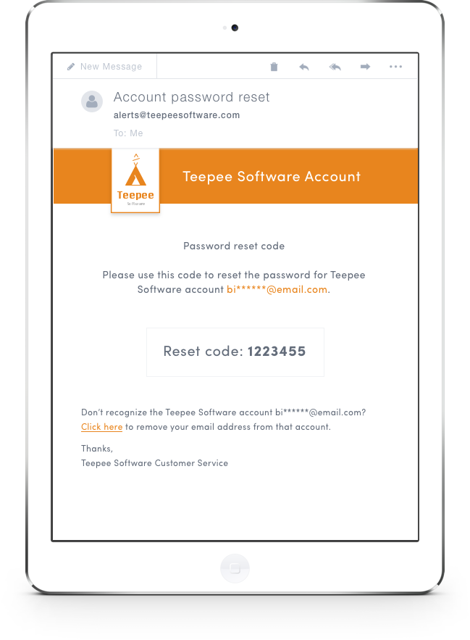
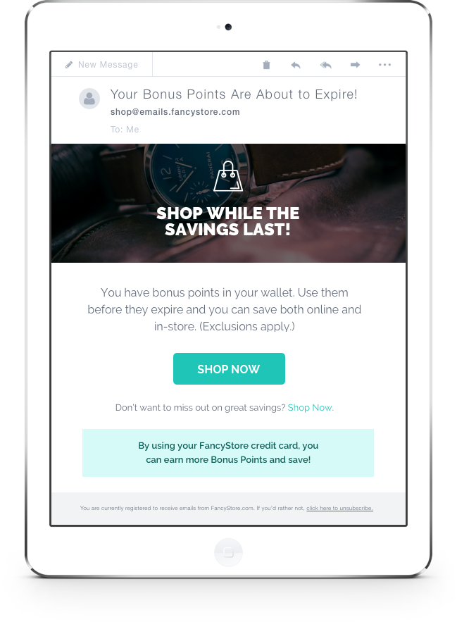
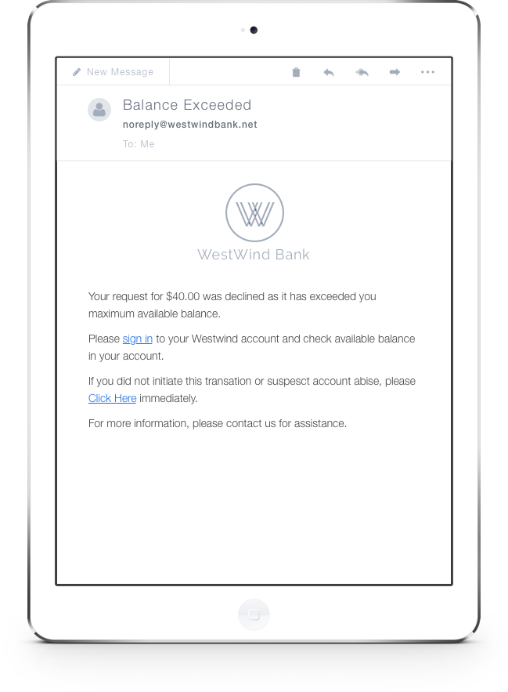
Can You Spot the Phish?
Notes:
So, can you spot a phish. Which of these do you think is suspect?

Slide 8
Can You Spot the Phish?
Genuine
Genuine
Phish
Poor grammar
Poor spelling
Urgency
Notes:
Did you get it?
Let’s have another go….

Slide 9
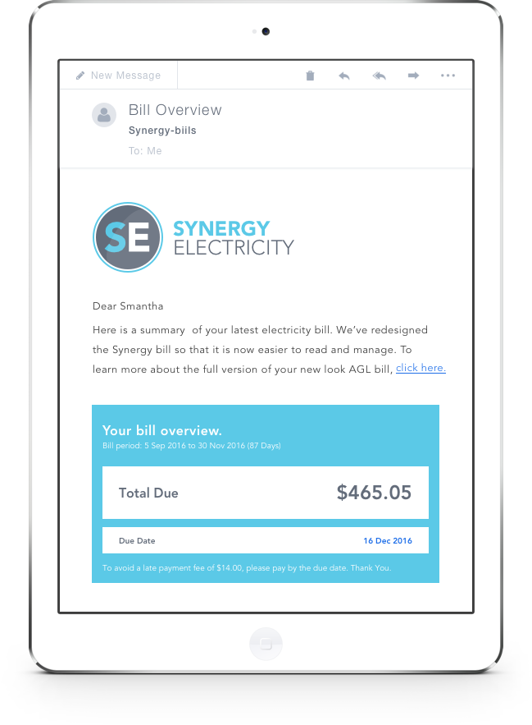
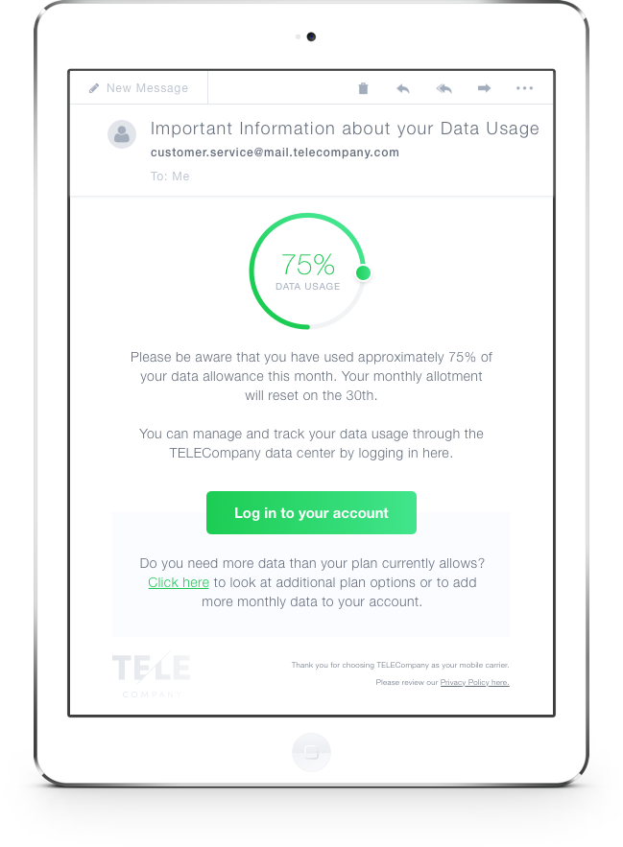
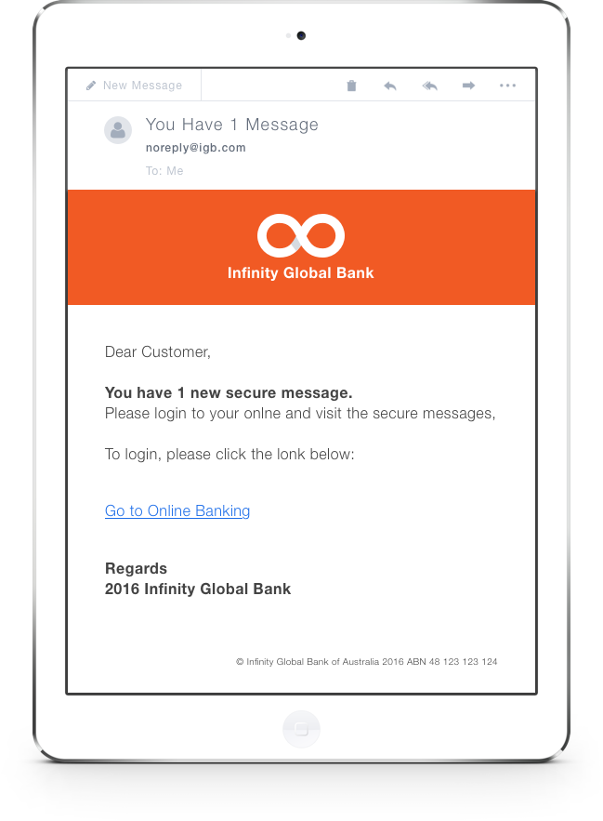
Can You Spot the Phish?
Notes:
Which of these do you think is phishing?

Slide 10
Can You Spot the Phish?
Phish
Genuine
Phish
Poor Spelling
Bad Formatting
Generic Salutation
Strange Wording
Poor punctuation
Poor spelling
Odd sign-off
Notes:
How did you get on this time?

Slide 11
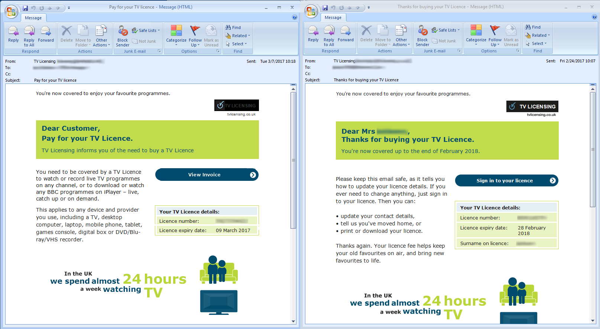
Genuine and Phishing Emails Are Often Very Similar
Phish
Genuine
Notes:
Phishing emails can be very, very convincing. This is an example of a UK TV licensing phish. You can see how similar the phishing email is to the genuine one.

Slide 12
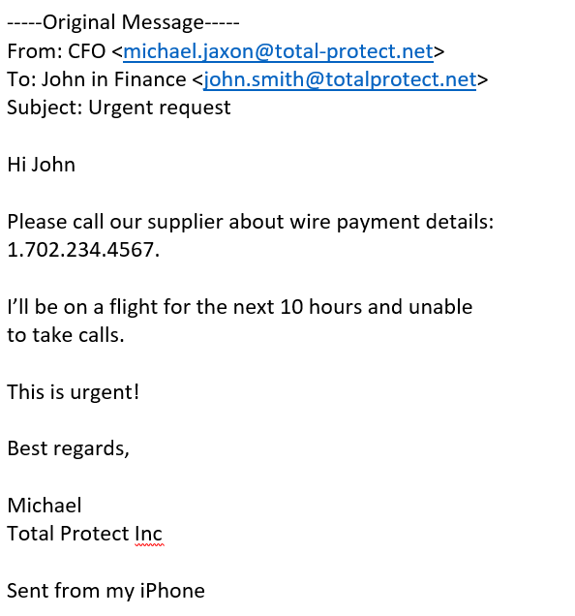
Don’t be Fooled by Format
Notes:
We’ve just had a look at some nicely formatted emails. But don’t think that all phishing emails are glossy. In this example here, the attacker has spoofed the CFO’s email address (see it’s total hyphen protect, not total protect), and makes it seem that the email is sent by his iPhone to make it more convincing.

Slide 13
Ten Tell Tale Tips to Spot Phishing Emails

Slide 14
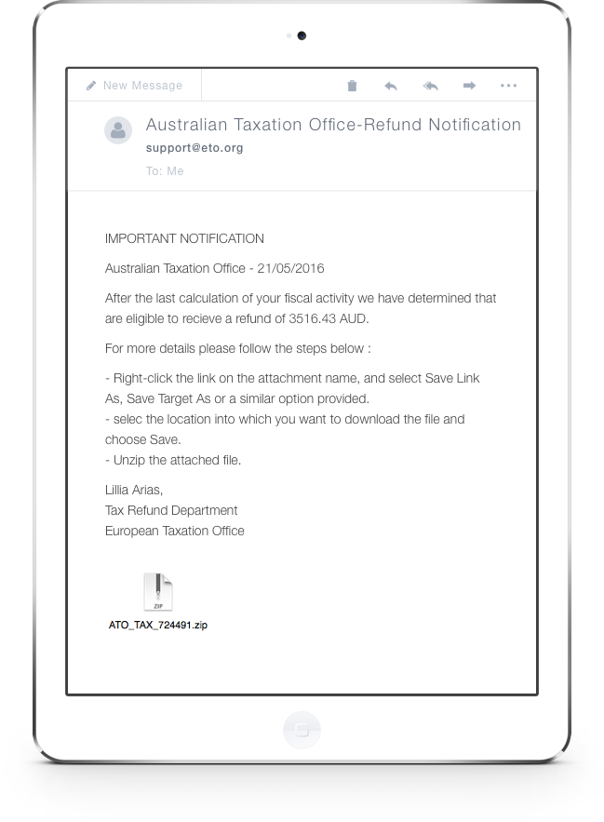
Ten Tell-Tale Signs of Phishing
1. Just doesn’t look right
Something off?
Too good to be true?
Trust your instincts
Too good to be true!
Notes:
Is there something a little off with the emails? Too good to be true? Trust your instincts if they tell you to be suspicious.

Slide 15
Ten Tell-Tale Signs of Phishing
1. Just doesn’t look right
2. Generic salutations
Generic Salutation
Notes:
Instead of directly addressing you, phishing emails often use generic salutations like “Dear Customer.” Using impersonal salutations saves the cybercriminals time so they can maximize their number of potential victims.

Slide 16
Ten Tell-Tale Signs of Phishing
1. Just doesn’t look right
2. Generic salutations
3. Official-looking site asking you to enter sensitive data
Sign in and provide sensitive (valuable) data
Notes:
These spoofed sites are often very convincing, so before revealing personal information or confidential data examine the site to make sure it’s real.

Slide 17
Ten Tell-Tale Signs of Phishing
1. Just doesn’t look right
2. Generic salutations
3. Official-looking site asking you to enter sensitive data
Specific on you
4. Unexpected email; specific information on YOU
Unexpected, from Senior Manager
Notes:
Information like job title, previous employment, or personal interests can be gleaned from social networking sites like LinkedIn and then used to make a phishing email more convincing.

Slide 18
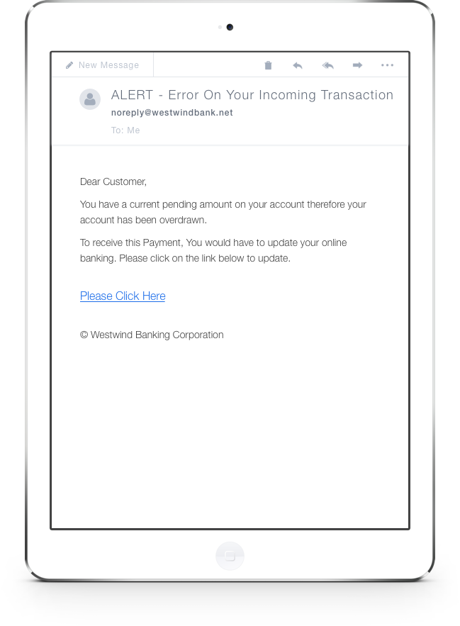
Ten Tell-Tale Signs of Phishing
1. Just doesn’t look right
2. Generic salutations
3. Official-looking site asking you to enter sensitive data
4. Unexpected email; specific information on YOU
5. Unnerving wording
Cause concern
Notes:
Thieves often use phrases meant to scare you (such as saying your account has been breached) to trick you into acting without thinking, and in doing so revealing information you ordinarily would not.

Slide 19
Ten Tell-Tale Signs of Phishing
Phish
1. Just doesn’t look right
2. Generic salutations
3. Official-looking site asking you to enter sensitive data
4. Unexpected email; specific information on YOU
Poor grammar
5. Unnerving wording
6. Poor grammar or spelling (or both)
Poor spelling
Notes:
Poor grammar or spelling is often a dead giveaway. Unusual syntax is also a sign that something is wrong.

Slide 20
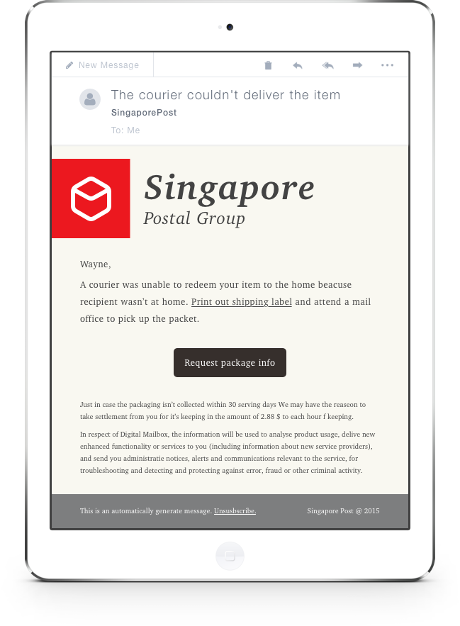
Ten Tell-Tale Signs of Phishing
1. Just doesn’t look right
2. Generic salutations
3. Official-looking site asking you to enter sensitive data
4. Unexpected email; specific information on YOU
5. Unnerving wording
6. Poor grammar or spelling (or both)
Urgency
7. Sense of urgency
Notes:
For example: “If you don’t respond within 48 hours, your account will be closed.” By convincing you the clock is ticking, thieves hope you’ll make a mistake.

Slide 21
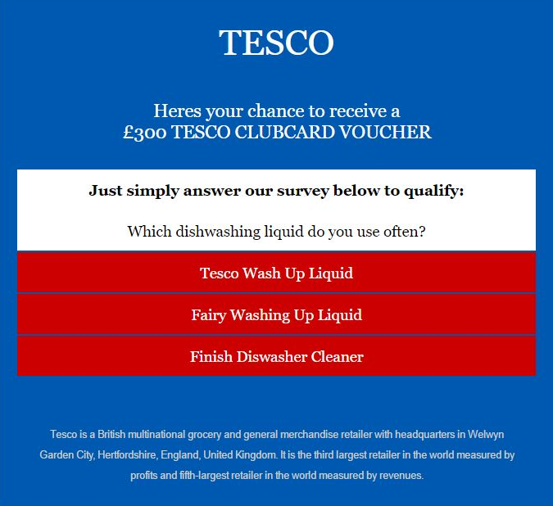
Ten Tell-Tale Signs of Phishing
1. Just doesn’t look right
Survey with incentive
2. Generic salutations
3. Official-looking site asking you to enter sensitive data
4. Unexpected email; specific information on YOU
5. Unnerving wording
6. Poor grammar or spelling (or both)
7. Sense of urgency
8. “You’ve won the grand prize” or take survey
Notes:
“You’ve won the grand prize!” or “You’ve got a parcel”. These phishing emails are common, but easy to spot. A similar, trickier variation is asking you to complete a survey in return for a prize.

Slide 22
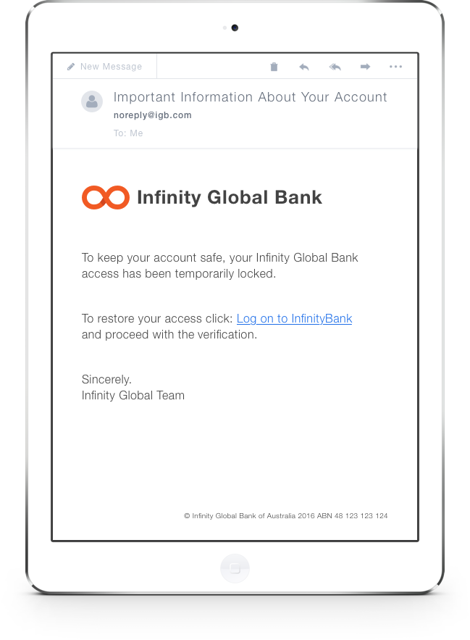
Ten Tell-Tale Signs of Phishing
1. Just doesn’t look right
2. Generic salutations
3. Official-looking site asking you to enter sensitive data
4. Unexpected email; specific information on YOU
5. Unnerving wording
6. Poor grammar or spelling (or both)
Visit site and enter sensitive data
7. Sense of urgency
8. “You’ve won the grand prize”
9. “Verify your account”
Notes:
These messages spoof real emails asking you to verify your account with a site or organization. Always question why you’re being asked to verify – there’s a good chance it’s a scam.

Slide 23
Ten Tell-Tale Signs of Phishing
1. Just doesn’t look right
2. Generic salutations
www.g00gle.com
vs.
www..google.com
3. Official-looking site asking you to enter sensitive data
4. Unexpected email; specific information on YOU
5. Unnerving wording
6. Poor grammar or spelling (or both)
7. Sense of urgency
8. “You’ve won the grand prize”
9. “Verify your account”
10. Cybersquatting
Notes:
Often, cybercriminals will purchase and “squat” on website names that are similar to an official website in the hopes that users go to the wrong site, such as www.google.com vs. www.g00gle.com. Always take a moment to check out the URL before entering your personal information.

Slide 24
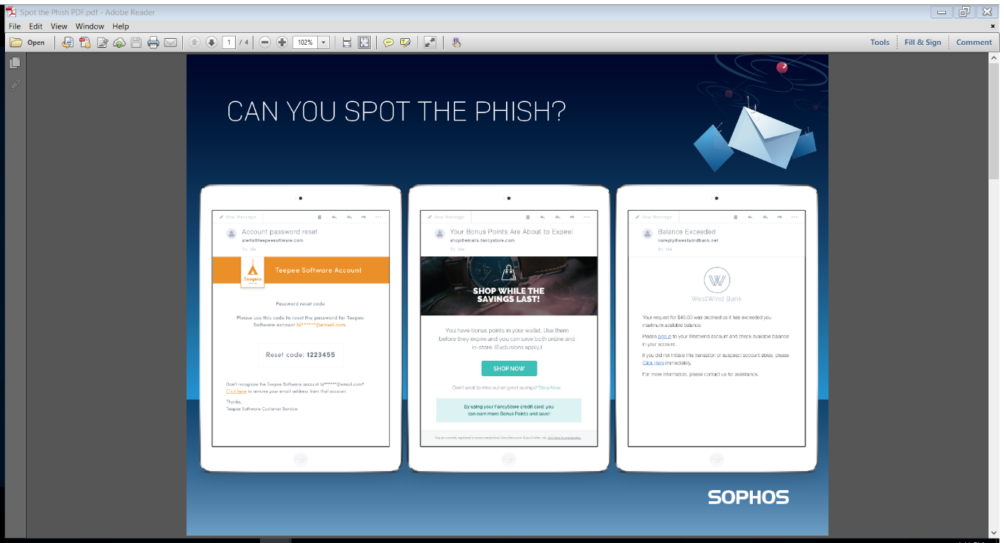
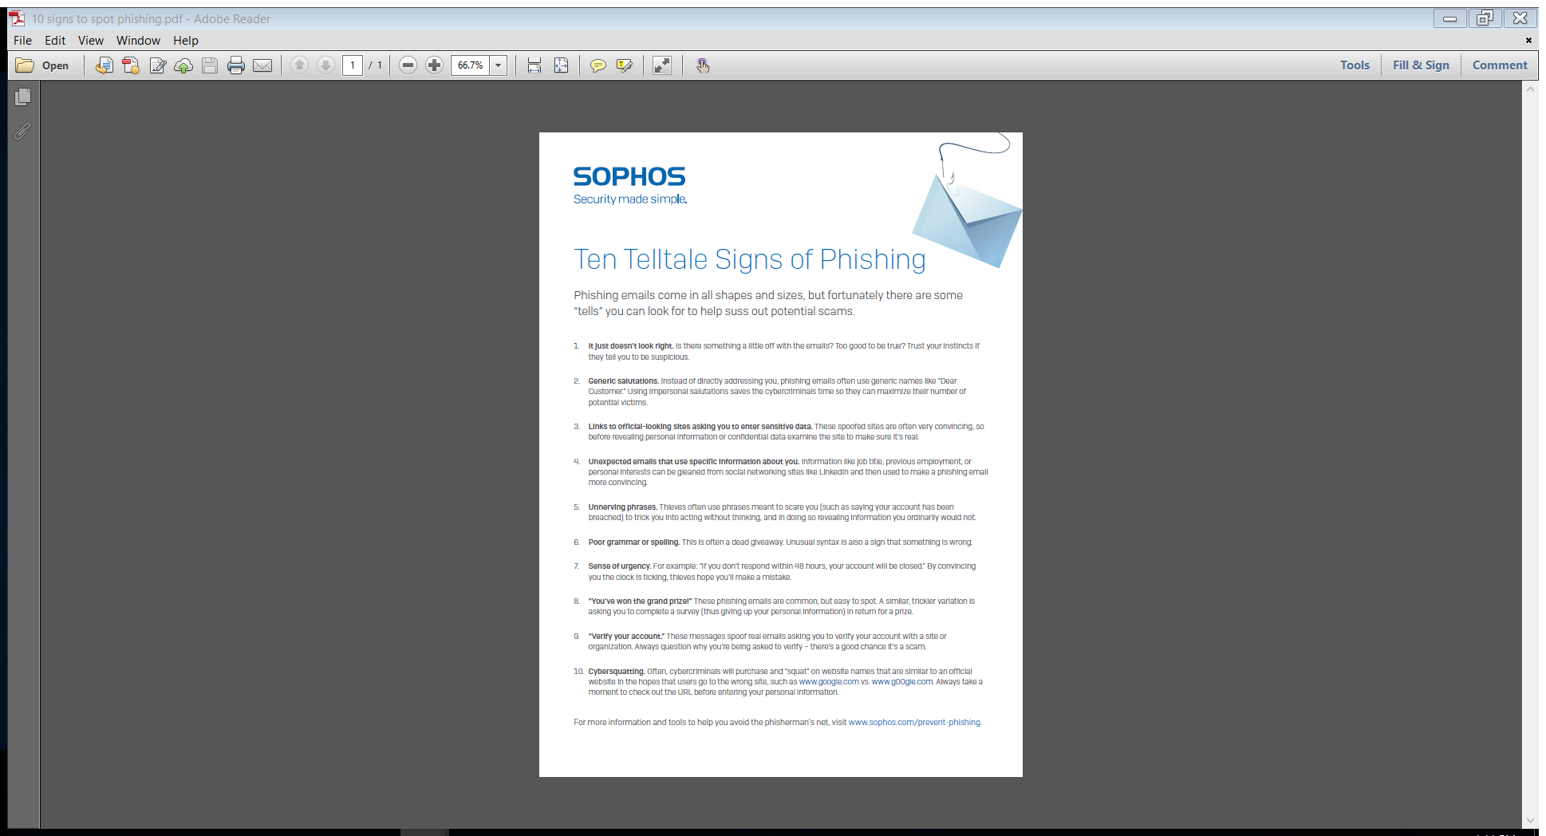
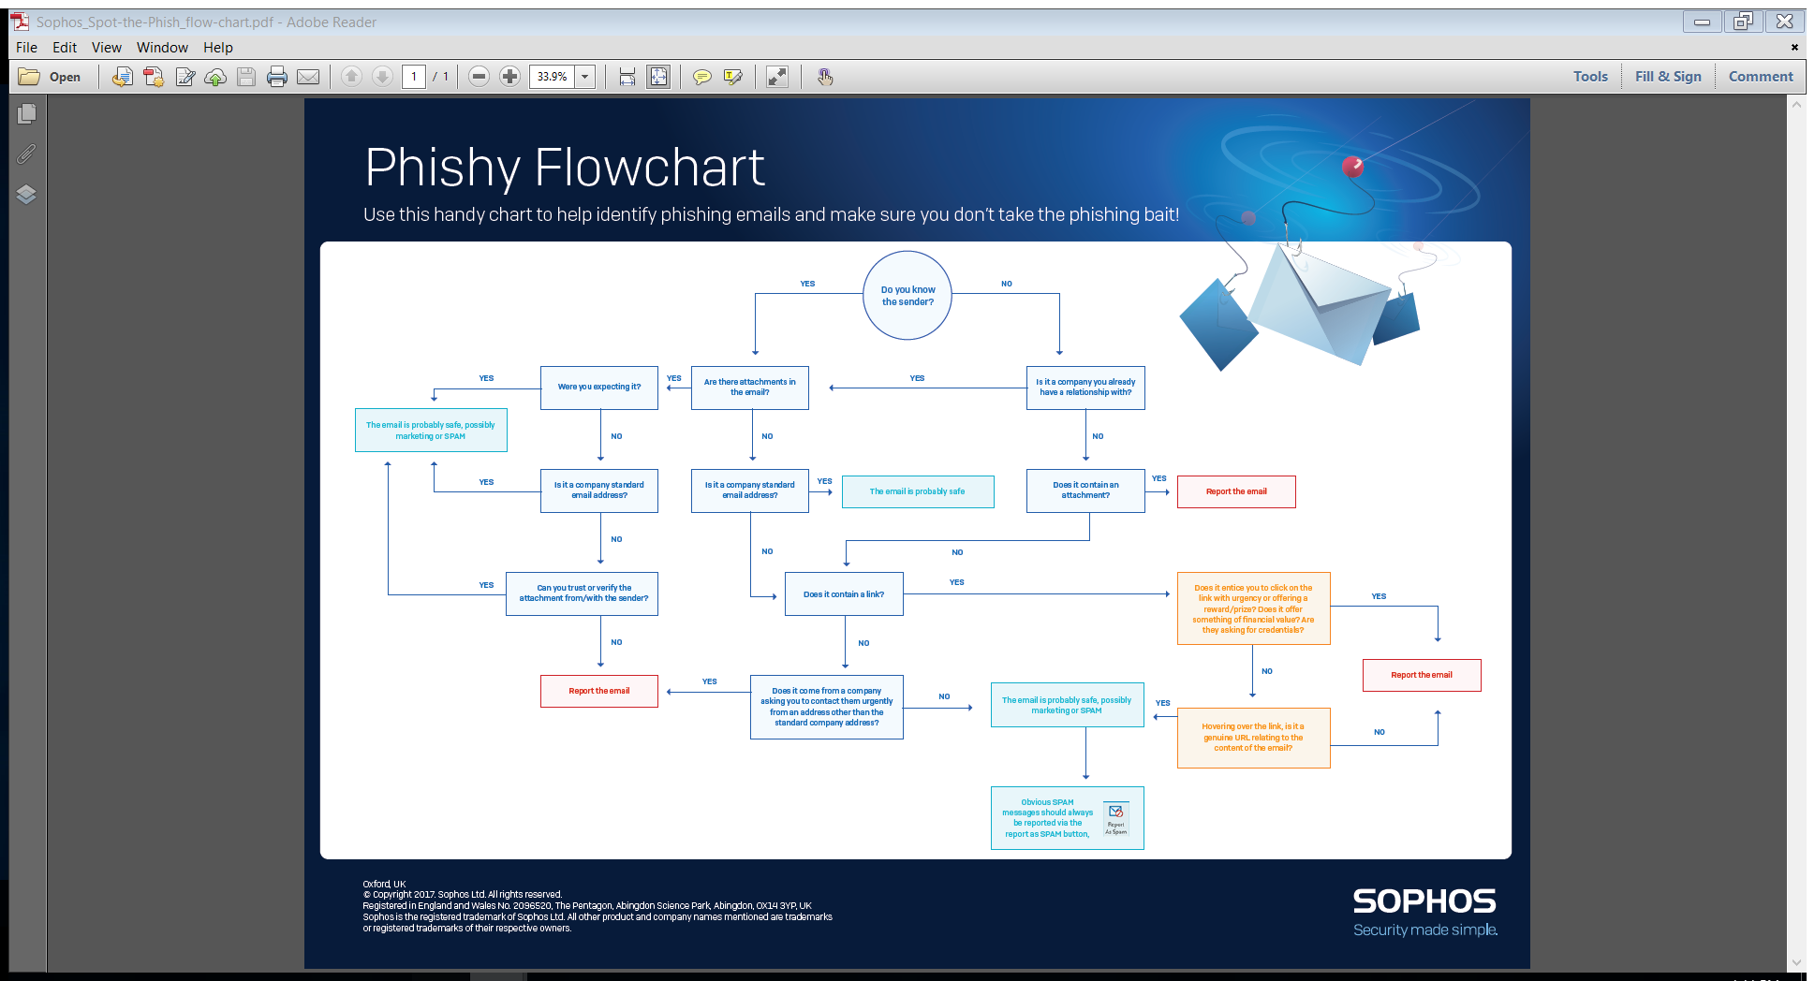
Resources to Help You Spot Phishing
10-tips to spot phishing emails
Phishy Flowchart
www.Sophos.com/prevent-phishing
Notes:
There are some handy resources to help you spot phishing at www.sophos.com/prevent-phishing

Slide 25



Don’t Take the Bait
Never respond to emails requesting personal financial information
Visit bank websites by typing their URL in the address bar
Keep a regular check on your accounts
Be cautious when opening attachments and downloading files from emails
Keep your computer secure
Sophos Home: Free IT security for the home www.sophos.com/home
“Our test was flawless…”
“Best-in-class protection…while leaving a small performance impact.”
“…able to detect and remove all malware samples 100 percent”
Notes:
And here are some other tips to help make sure you don’t take the phishing bait.

